Slide 1
Content Based Image Retrieval and Image Processing using Hadoop
Ashish Agarwal (Y11UC062)
Ayush Kasliwal (Y11UC069)
Mahak Jain (Y11UC128)

Slide 2
Problem Statement - 1
As Internet is expanding, creation of data over it is also increasing exponentially. Maximum part of this data contains images. Processing the large data sets of regular images often require more processing capability.
Proposed solution will be a system to extract the features of the images among massive image data storage using distributed image processing using Map Reduce technique.

Slide 3
Problem Statement - 2
Most traditional and common methods of image retrieval utilize method of adding metadata such as captioning, keywords, or descriptions to the images so that retrieval can be performed over the annotation words.
Proposed solution will be a system to upload, search and query images among massive image data storage using content based image retrieval scheme using Map Reduce technique.

Slide 4
Introduction
Computer Cluster
Apache Hadoop
Map Reduce
Distributed Image Processing
Content Based Image Retrieval

Slide 5
Computer Cluster
A computer cluster is a single logical unit consisting of multiple computers that are linked through a LAN.
The networked computers essentially act as a single, much more powerful machine.
A computer cluster provides much faster processing speed, larger storage capacity, better data integrity, superior reliability and wider availability of resources.

Slide 6
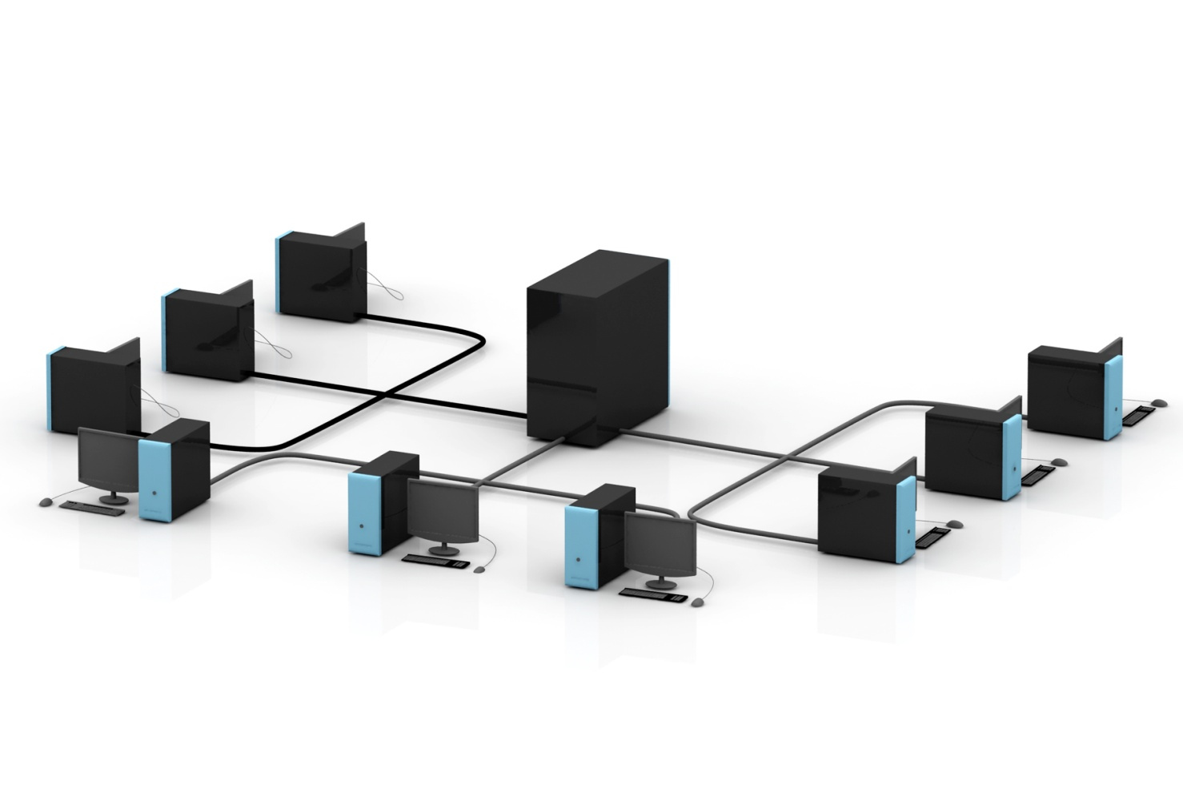
Computer Cluster

Slide 7
Apache Hadoop
Apache Hadoop is an open-source software framework written in Java for distributed storage and distributed processing of very large data sets on computer clusters built from commodity hardware.
The core of Apache Hadoop consists of:
HDFS (Hadoop Distributed File System)
Map-Reduce

Slide 8
HDFS
The Hadoop distributed file system (HDFS) is a distributed, scalable, and portable file-system written in Java for the Hadoop framework.
HDFS provides high throughput access to application data and is suitable for applications that have large data sets.

Slide 9
Map Reduce
MapReduce is a programming model and an associated implementation for processing and generating large data sets with a parallel, distributed algorithm on a cluster.
The term Map Reduce actually refers to two separate and distinct tasks that Hadoop programs perform.

Slide 10
Map Reduce
Map job, which takes a set of data and converts it into another set of data, where individual elements are broken down into tuples (key/value pairs).
The reduce job takes the output from a map as input and combines those data tuples into a smaller set of tuples.

Slide 11
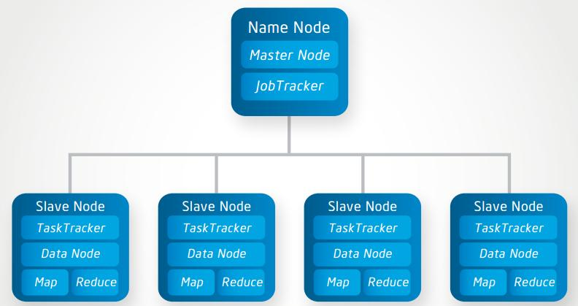
Hadoop Master/Slave Architecture

Slide 12
Image Processing
The analysis of a picture using techniques that can identify shades, colours and relationships that cannot be perceived by the human eye.
Image processing is used to solve identification problems, such as in forensic medicine or in creating weather maps from satellite pictures.

Slide 13
Content Based Image Retrieval
An image retrieval system is designed to browse, search and retrieve images from large database of digital images.
CBIR aims at avoiding the use of textual descriptions and instead retrieves images based on similarities in their contents to a user-supplied query image or user-specified image features.
The term content in this context might refer to colours, shapes, textures or any other information that can be derived from the image itself.

Slide 14
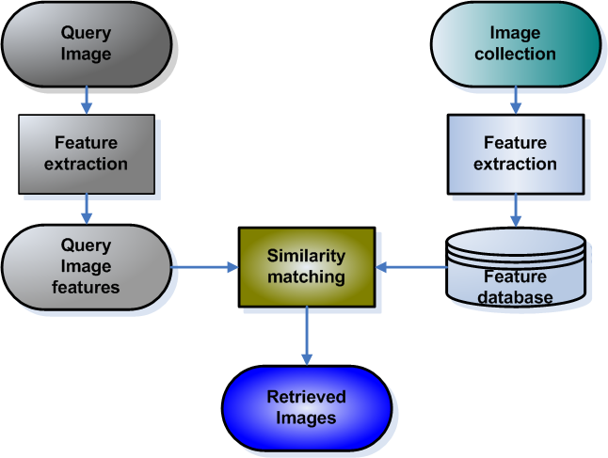
Content Based Image Retrieval

Slide 15
Distributed Image Processing

Slide 16
Distributed Image Processing
Algorithms/Techniques:
Image Format Change
Image Gray Scale Conversion
Image Blurring
Image Filtering (Edge Detection)
Colour Histogram
Face Detection

Slide 17
OpenIMAJ
OpenIMAJ is a set of libraries and tools for multimedia content analysis and content generation.
OpenIMAJ is primarily written in pure Java and, as such, is completely platform independent.
The OpenIMAJ software is structured into a number of modules. The modules can be used independently.

Slide 18
Image Format Change
Convert PNG to JPG image format.
PNG format is a lossless compression file format. JPG format is a lossy compressed file format.
Therefore, PNG requires more space than JPG.

Slide 19
Gray Scale Conversion
Greyscale digital image is an image in which the value of each pixel is a single sample, that is, it carries only intensity information.
RGB has 3 channels red, green and blue.
Gray scale image can also be used for processing (occupies less memory).
P(x,y) = 0.2989 * P(r,x,y) + 0.5870 * P(g,x,y) + 0.1140 * P(b,x,y)

Slide 20
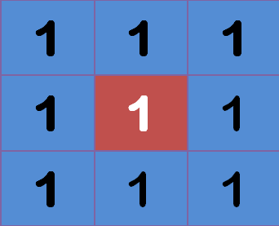

Image Blurring
An image looks more sharp or more detailed if we are able to perceive all the objects and their shapes correctly in it.
In blurring , we simple reduce the edge content and makes the transition form one colour to the other very smooth.

Slide 21
Image Filtering (Edge Detection)
Edge detection is an image processing technique for finding the boundaries of objects within images.
It works by detecting discontinuities in brightness.
Edge detection is used for image segmentation and data extraction in areas such as image processing, computer vision, and machine vision.
Common edge detection algorithms used are Canny, Sobel etc.

Slide 22
Colour Histogram
Colour Histogram of an image gives extensive information about its structure. It gives number of pixels, its colours in RGB format etc.
By looking at the histogram for a specific image a viewer will be able to judge the entire intensity distribution at a glance.
This feature can be used to compare with input image's feature and to retrieve all similar images from database.

Slide 23
Face Detection
Face detection is a computer technology that identifies human faces in digital images.
It detects human faces which might then be used for recognizing a particular face.
Used OpenIMAJ library functions to detect the faces.

Slide 24
Algorithm
Mapper:
Input: Takes image from HDFS database. For each image new mapper will be executed.
Processing: Corresponding image processing algorithm runs over that image.
Output: Key/Value pair where,
Key: Image name
Value: Corresponding algorithm output.
Reducer:
Takes key/value as output from mapper.
Store the sorted keys corresponding to processed image.

Slide 25
Content Based Image Retrieval

Slide 26
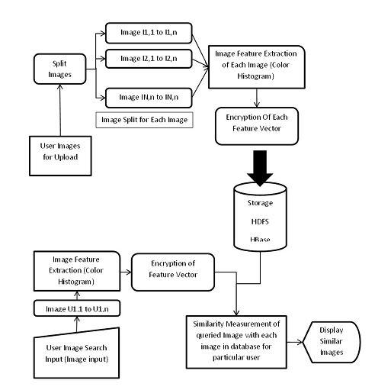
Face Detection

Slide 27
Content Based Image Retrieval
Phase 1: Image Upload
Phase 2: Feature Extraction
Phase 3: Image Matching

Slide 28
Algorithm
Phase 1:
Image data set which is going to be uploaded is first split into different images. This step is taken to disperse data across.
Map/Reduce technique works on its distributed file system called as Hadoop Distributed File System(HDFS).
All image files are stored into file system.

Slide 29
Algorithm
Phase 2:
These images are given to the image processing part.
In this phase, Colour Histogram of each image is calculated.
This histogram will provide different feature values such as entropy, intensity etc.

Slide 30


Algorithm
Phase 3:
These values are used for the similarity calculation of images i.e. distance between input image and images from HDFS.
Euclidean Distance:
Cosine Similarity:

Slide 31
Conclusion
On similarity measurement front, application is successful in uploading, searching and retrieving similar images up to certain precision for same format and same dimension of image data.
Variation in dimension and format varies the output similarity precision.

Slide 32
Conclusion
For execution time complexity, application is tested on single node and multi node clusters configurations.
Multi node clusters delivers high performance and increases time eciency nearly by 40%.

Slide 33
Future Work
This application is designed in such a way that it will try to cover different domains. It does not use detailed research work from any of the domain.
This application has large scope in cloud domain and internet world because every domain servers are using cloud technology and they want to provide their customers a new cutting edge applications for imaging which are efficient.

Slide 34
Thank You

